Slide 1
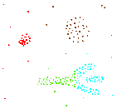
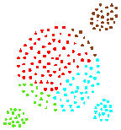
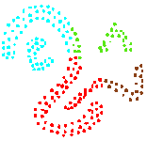
Density Based Clustering
DBSCAN (Density based spatial clustering of applications with noise)
Most partitioning (clustering) methods cluster objects based on the distance between objects
Such methods can find only spherical-shaped clusters and encounter difficulty at discovering of arbitrary shapes
Results of a k-means algorithm for k=4

Slide 2
Density Based Clustering
DBSCAN (Density based spatial clustering of applications with noise)
Other methods have been developed based on the notion of density
Their general idea is to continue growing the given cluster as long as the density (number of data points) in the neighbourhood exceeds some threshold

Slide 3
Density Based Clustering
DBSCAN (Density based spatial clustering of applications with noise)
That is, for each data point within a given cluster, the neighbourhood of a given radius has to contain at least a minimum number of points
Such methods can be used to filter out noise (outliers), and discover clusters of arbitrary shape

Slide 4
Density Based Clustering
DBSCAN (Density based spatial clustering of applications with noise)
The neighbourhood within a radius ε of a given object (data point) is called the ε neighbourhood of the object.
If the ε neighbourhood of an object contains at least a minimum number, MinPts, of objects, then the object is called a core object.
ε

Slide 5
Density Based Clustering
DBSCAN (Density based spatial clustering of applications with noise)
We say that an object p, is directly density-reachable from a core object q if p is within the ε neighbourhood of q
q
p

Slide 6
Density Based Clustering
DBSCAN (Density based spatial clustering of applications with noise)
An object p is density-reachable from object q, if there is a chain of objects p₁, …, p_{n} ; where p₁ = q and p_{n} = p such that p_{i+1} is directly density reachable from p_{i}
q
p

Slide 7
Density Based Clustering
DBSCAN (Density based spatial clustering of applications with noise)
An object p is density-connected to object q, if there is an object o such that both p and q are density reachable from o
o
p
q

Slide 8
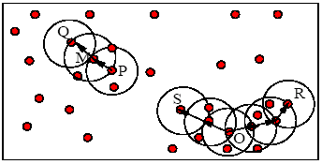
Density Based Clustering
DBSCAN (Density based spatial clustering of applications with noise)
M, P, O and R are core objects, if MinPts = 3
P and Q are directly density reachable from M and M is directly density reachable from P

Slide 9
Density Based Clustering
DBSCAN (Density based spatial clustering of applications with noise)
Q is density reachable from P, but P is not density reachable from Q
S, O, R are all density connected

Slide 10
Density Based Clustering
DBSCAN (Density based spatial clustering of applications with noise)
A cluster is a set of density-connected objects
Noise is the set of objects not contained in any cluster.

Slide 11
Density Based Clustering
DBSCAN (Density based spatial clustering of applications with noise)
Arbitrary select a point p
Retrieve all points density-reachable from p wrt Eps and MinPts.
If p is a core point, a cluster is formed.
If p is a border point, no points are density-reachable from p and DBSCAN visits the next point of the database.
Continue the process until all of the points have been processed.

Slide 12
DBSCAN Algorithm: Example
Parameter
ε = 2 cm
MinPts = 3

Slide 13
DBSCAN Algorithm: Example
Parameter
ε = 2 cm
MinPts = 3

Slide 14
DBSCAN Algorithm: Example
Parameter
ε = 2 cm
MinPts = 3

Slide 15
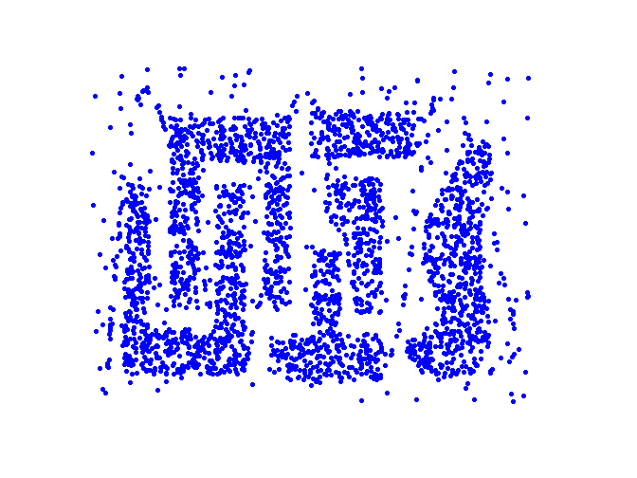
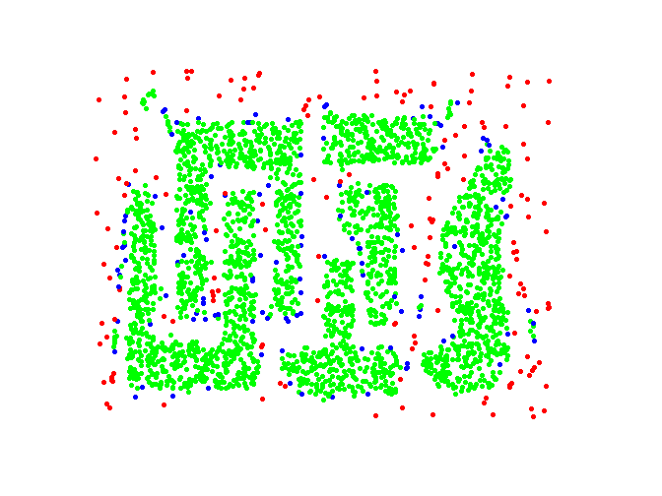
Example
Original Points
Point types: core, border and outliers
ε = 10, MinPts = 4

Slide 16
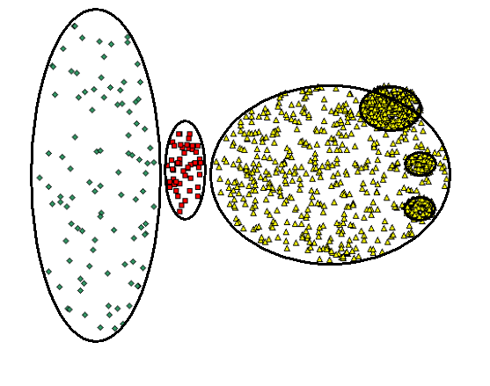
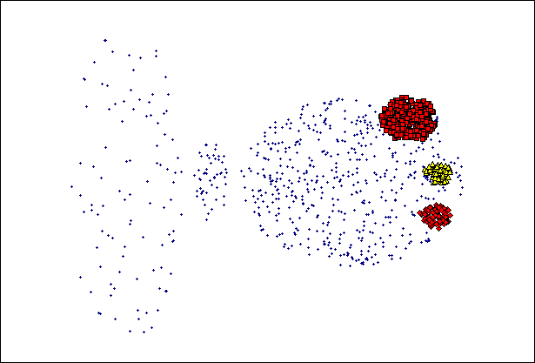
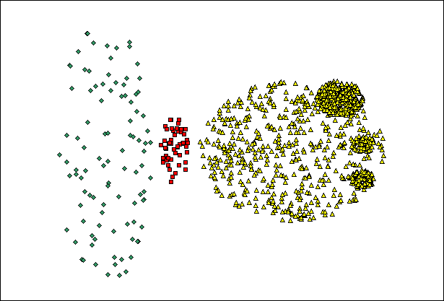
When DBSCAN Does NOT Work Well
(MinPts=4, Eps=9.92).
Original Points
cannot handle Varying densities
sensitive to parameters
(MinPts=4, Eps=9.75)

